Slide 1
Goal of the presentation
- Train you on performing Qualitative Assessment of my results
- My results are reports generated by LLMs
- You will see a model based on the same architecture but on an unrelated topic, you will not see it again
- You should assess my results not for my own pleasure but by being objective towards the real quality of the results, this is essential for my paper
- Your results should be objective individually and collectively

Slide 2
Context Prompt Architecture
Role
Goal & Instructions
Parameters
Documentation

Slide 3
Context Prompt
You are an expert in Urban Planning without any statistics background.
Your goal is to explain an agent-based model. Your explanation must include the context of the model, its goals, and key parameters. For each parameter, include the range of values (if provided) and the value that we have set. Do not write any summary or conclusion. We have 12 parameters:
traffic-density, from 0.1 to 1.0. We set it to 0.75.
public-transport-usage, from 0.0 to 1.0. We set it to 0.45.
walking-preference, from 0.0 to 1.0. We set it to 0.30.
cycling-preference, from 0.0 to 1.0. We set it to 0.25.
car-ownership, from 0.0 to 1.0. We set it to 0.65.
green-space-availability, from 0.0 to 1.0. We set it to 0.5.
pollution-awareness, from 0.0 to 1.0. We set it to 0.6.
social-interaction-rate, from 0.0 to 1.0. We set it to 0.4.
urban-density, from 0.0 to 1.0. We set it to 0.8.
employment-rate, from 0.0 to 1.0. We set it to 0.7.
leisure-facilities-access, from 0.0 to 1.0. We set it to 0.5.
number-of-agents. We set it to 500.

Slide 4
Question Time
The model is about :
A) Simulating virus pandemic spreading across urban areas
B) Simulating urban mobility patterns and the use of various transportation modes by city residents.
C) Analyzing the environmental impact of different modes of transportation on the city's air quality and noise levels

Slide 5
Context Prompt
The context and goals of the model are as follows. The overall objective of the agent-based model is to simulate urban mobility patterns and the use of various modes of transportation by the population of a mid-sized city. Specifically, the goal of the model is to explore the influence of transportation preferences, availability of public and private transport options, and urban infrastructure on the daily movement and interaction of city residents. The model aims to replicate the changes in transportation behaviors and the usage patterns of different mobility options over time.
There are different mechanisms for how agents choose their modes of transportation, representing a preference-based approach and an availability-based approach. Decision-making follows a basic structure of: agent perception of transportation options, the triggering, or not, of disposition to consider alternatives, a set of scored choice functions made up of the perceived characteristics and modulated by personal preferences and social influence, and finally, choice evaluation where agents consider the impact of their choices and may adjust their future decisions.

Slide 6
Question Time
People choose their transportation mode on a :
A) preference-based approach and an availability-based approach
B) preference-based approach and an environmental-based approach
C) preference-based approach and an social-based approach

Slide 7
Context Prompt
The agents in the model represent urban residents who occupy a random position in the city. Each agent has a disposition to consider alternative transportation modes. Each agent makes a choice of transportation based on a function for each alternative, made up of the perceived convenience and environmental impact of each choice. These are computed at the initialization of the simulation and then calculated at each time step. An agent's transportation choice function is modified by personal preferences, social influence, and evaluation of previous choices. Agents ascribe different relative importance to each constituent part of the choice function (convenience and environmental impact). If the disposition requirement has been met, the usage of each transportation mode is split proportionately by the size of each choice function, modulated by the other influences. If not, agents keep their existing choice.
Agents start with an existing choice based on the dominant mode of transportation in the city at the start year of the data. All agents are part of a social network. Each agent in the network can sense and be influenced by the choice function of each transportation alternative for other agents in their network. Links between agents are unidirectional, and influence occurs as a function of interaction probability, with the degree of influence characterized by agent susceptibility. Social norms are globally perceived by agents and impact the weightings of the choice function.

Slide 8
Question Time
The population initial existing choice is based on:
A) Whether they already have a private car or not
B) Whether the public transportation is costly or not
C) The dominant mode of transportation in the city at the start of the year
D) The dominant mode of transportation in the city last year
E) The most environmental friendly mode of transportation

Slide 9
Trend Analysis Prompt Architecture
Role
Goal & Instructions
Plot

Slide 10
Trend Analysis Prompt
You are an expert in Urban Planning with a statistics background.
We have a plot from repeated simulations of an agent based model. Your goal is to describe the trends in details from the plot, mentioning key time steps and values taken by the metric in the plot, and interpreting them based on the context of the model. The report must objectively describe the trends in the data without addressing the quality of the simulation. Do not refer to the plot or any visual in your description. If a plot has very simple dynamics, simply state them without expanding.
The attachment is the plot representing the {metric}.
Example of metric : {mean usage of private transportion}

Slide 11
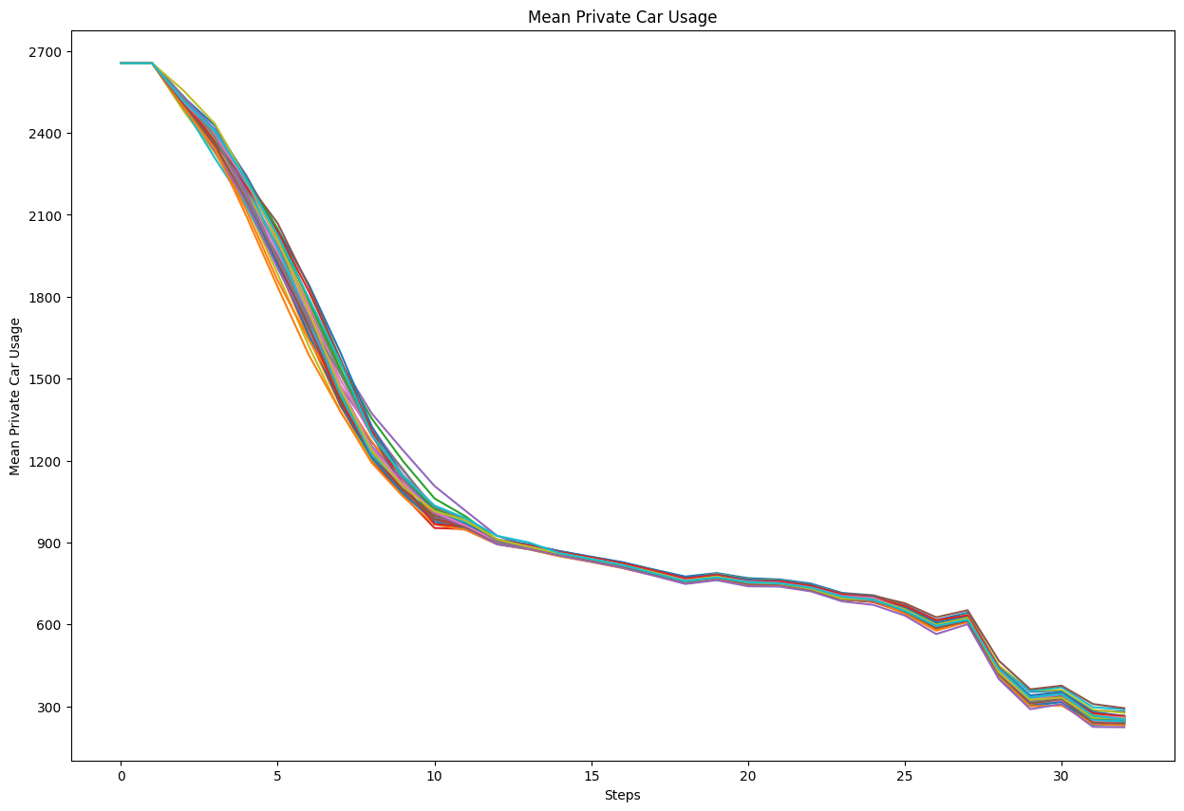
Plots

Slide 12
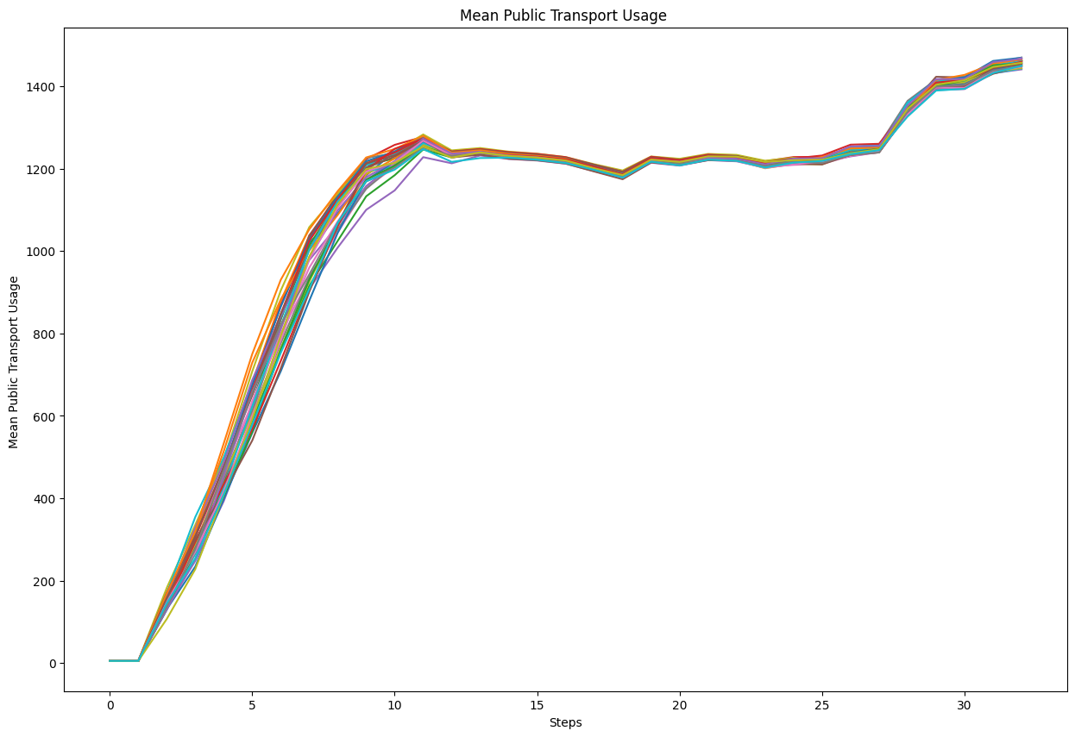
Plots

Slide 13
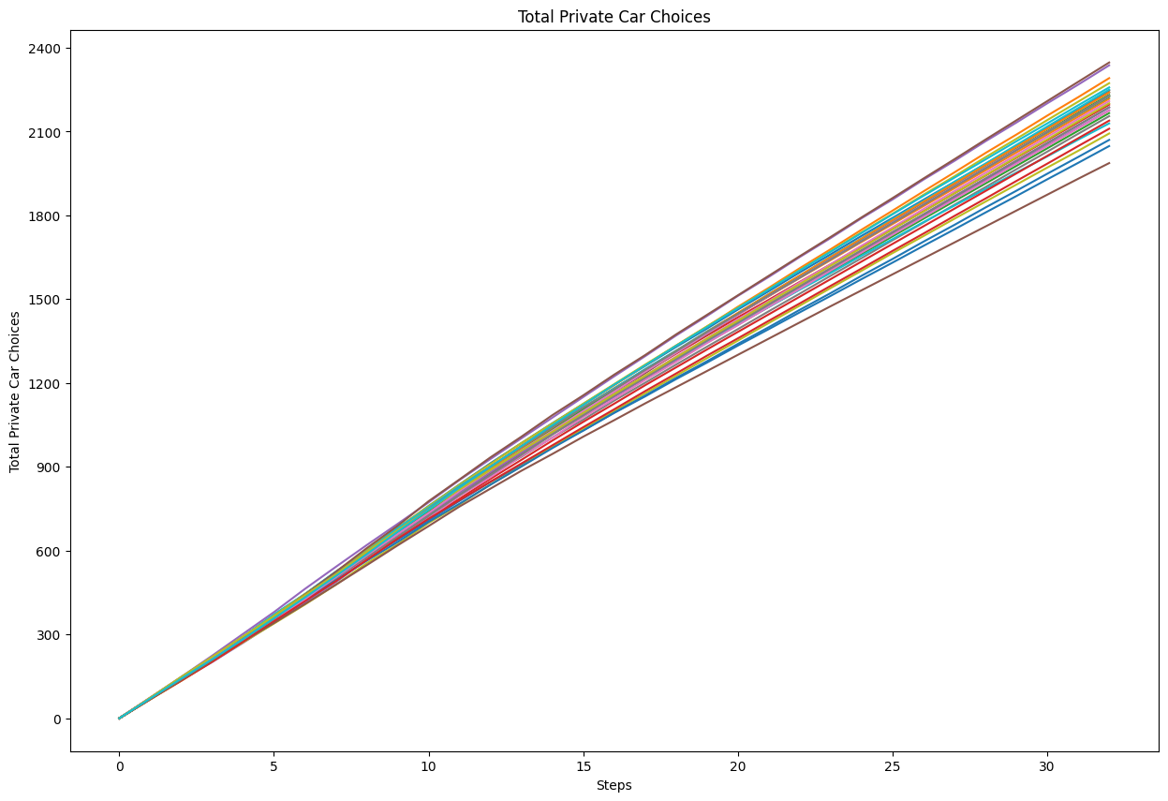
Plots

Slide 14
Question Time
How is the mean private car usage evolving ?
A) Overall Increasing
B)Overall Decreasing
C)Overall not changing

Slide 15
Question Time
What is the approximate final value for the total private car choices made?
A) 2400
B)20000
C)3500

Slide 16
Question Time
The Mean Public Transport Usage is :
A) Increasing linearly
B)Increases slowly and then sharply rises
C) Increases sharply and then slowly rises

Slide 17
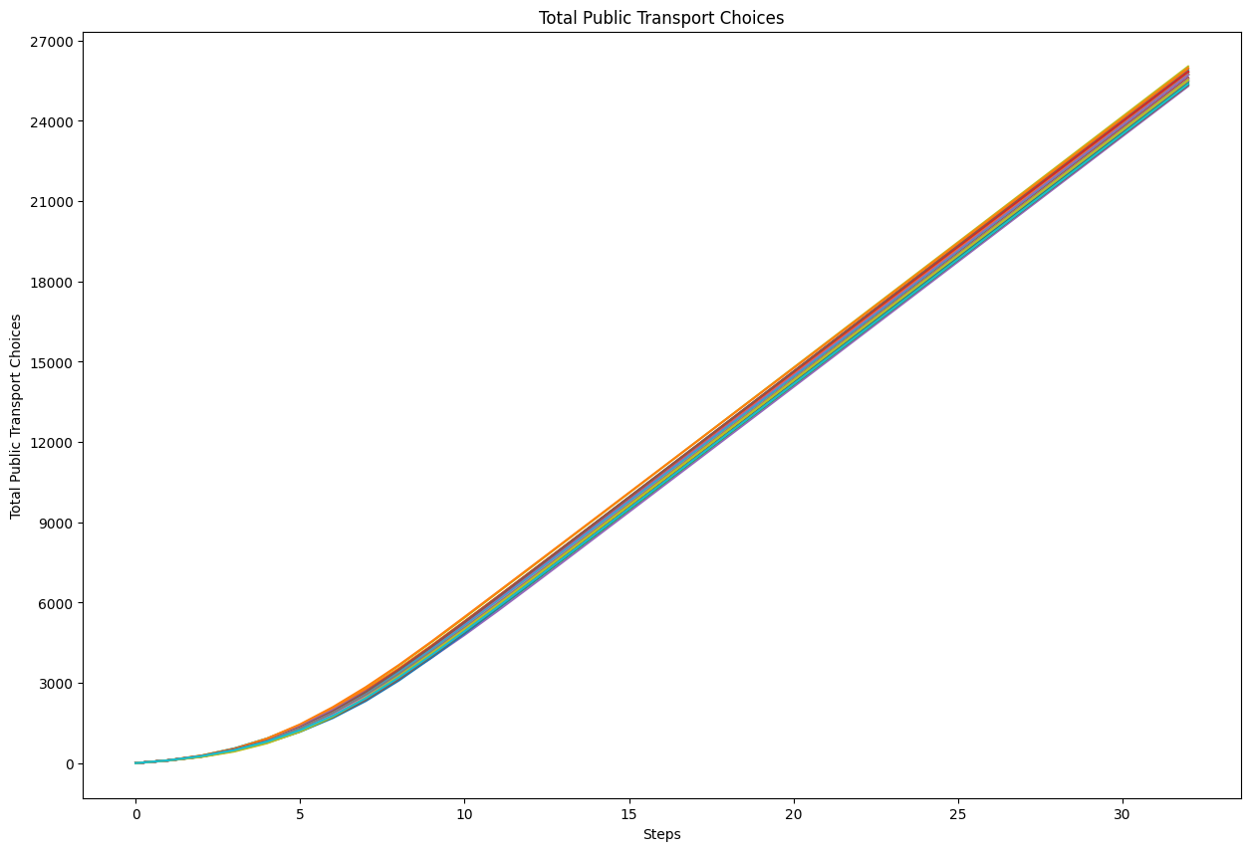
Plots

Slide 18
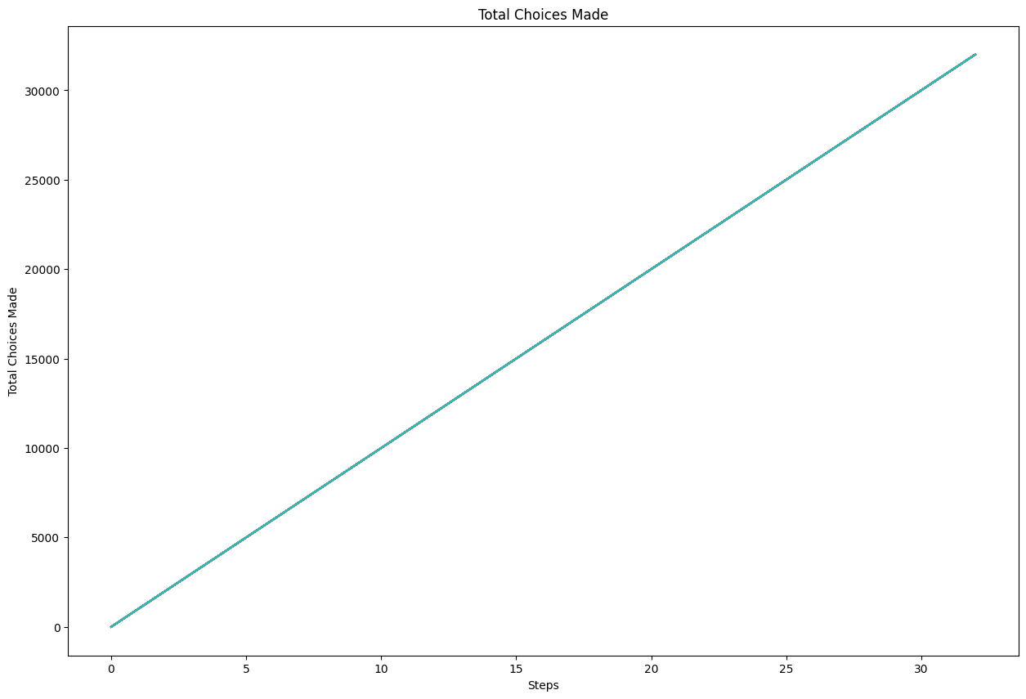
Plots

Slide 19
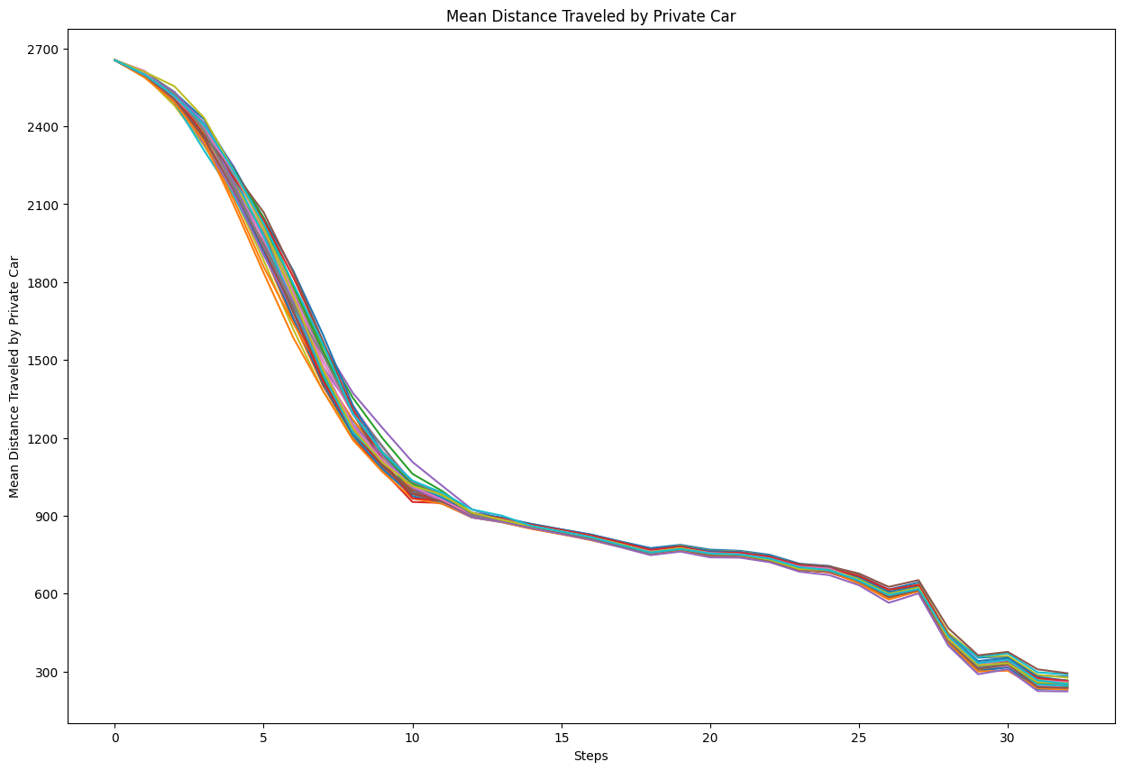
Plots

Slide 20
Question Time
The Mean Distance Traveled by Private Car is :
A) Increasing linearly
B) Decreasing
C) Increases sharply
D)Not changing

Slide 21
Question Time
The Total Choices Made is reaching:
A) 40000
B) 30000
C) 20000
D) 10000

Slide 22
Question Time
The Total Public Transport Choices starts at:
A) 1000
B) 100
C) 0
D) 500

Slide 23
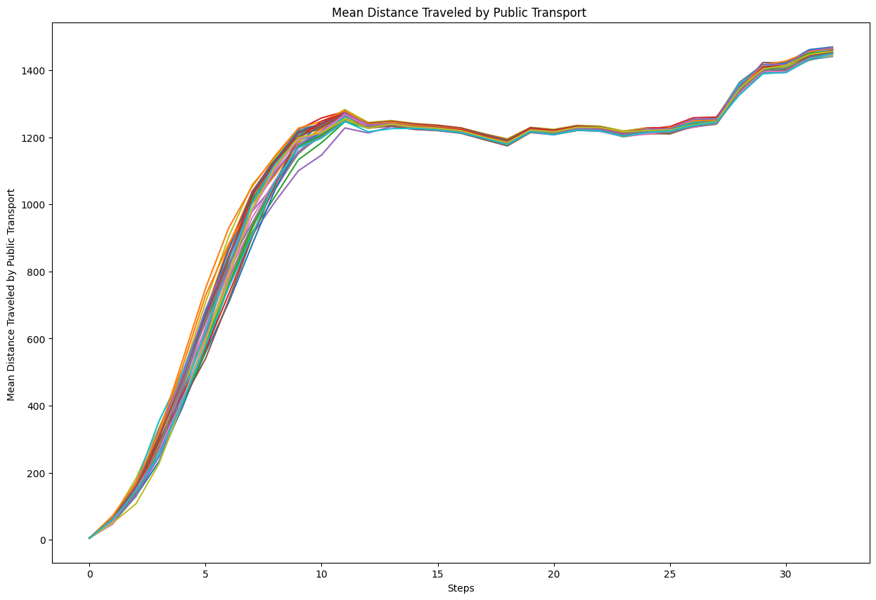
Plots

Slide 24
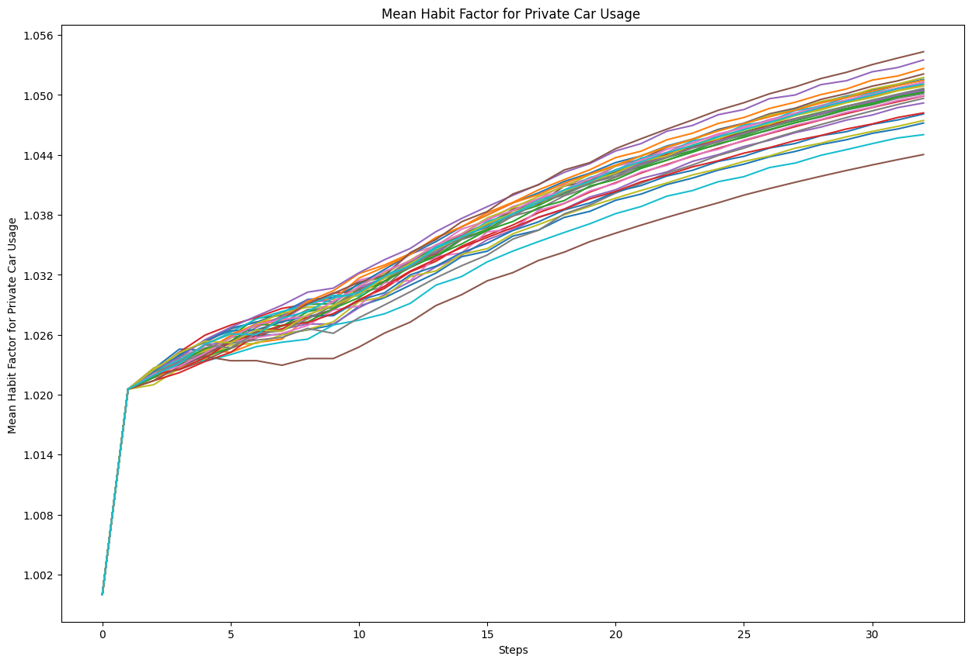
Plots

Slide 25
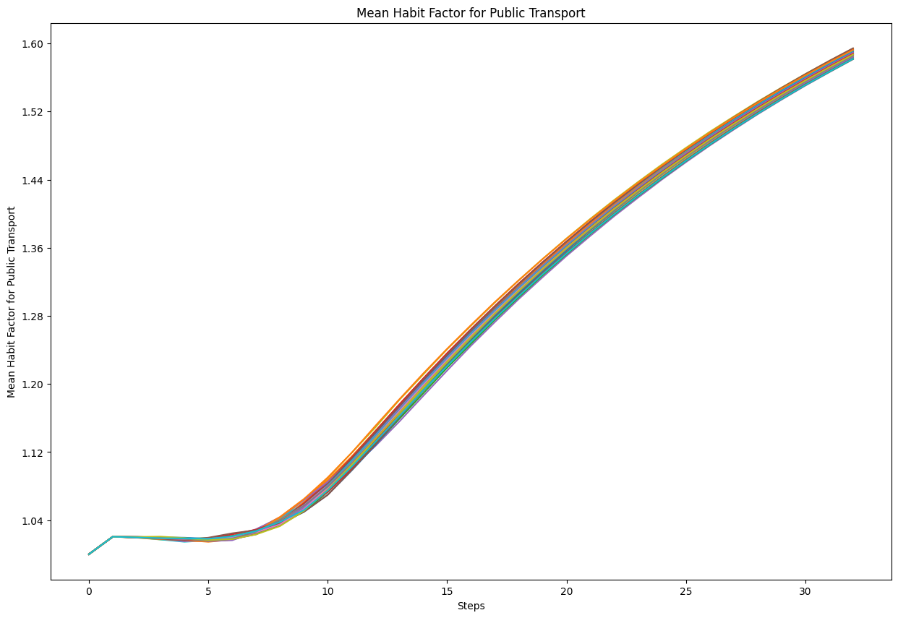
Plots

Slide 26
Question Time
The Mean Habit Factor for Public Transport is reaching :
A) 1.60
B) 160
C) 16

Slide 27
Question Time
The Mean Habit Factor for Private Car Usage is reaching :
A) 1.05
B) 15
C) 1.5

Slide 28
Question Time
The Mean Distance Traveled by Public Transport is :
A) Overall increasing
B) Overall decreasing
C) Overall the same

Slide 29
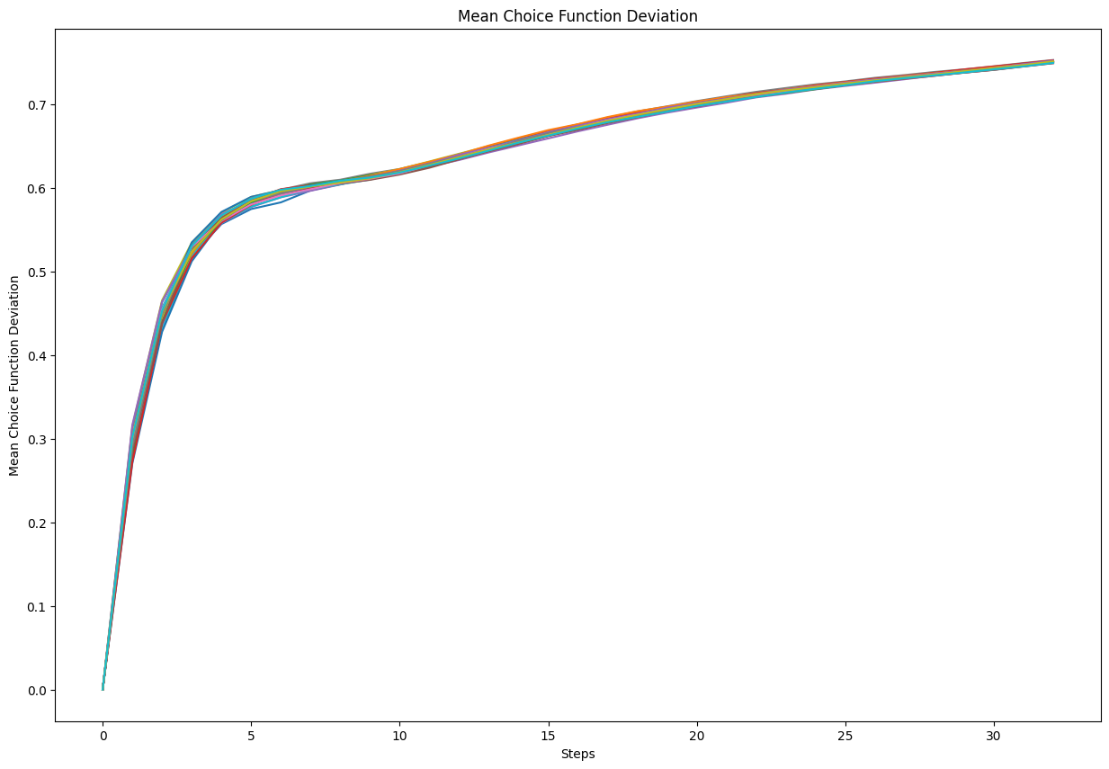
Plots

Slide 30
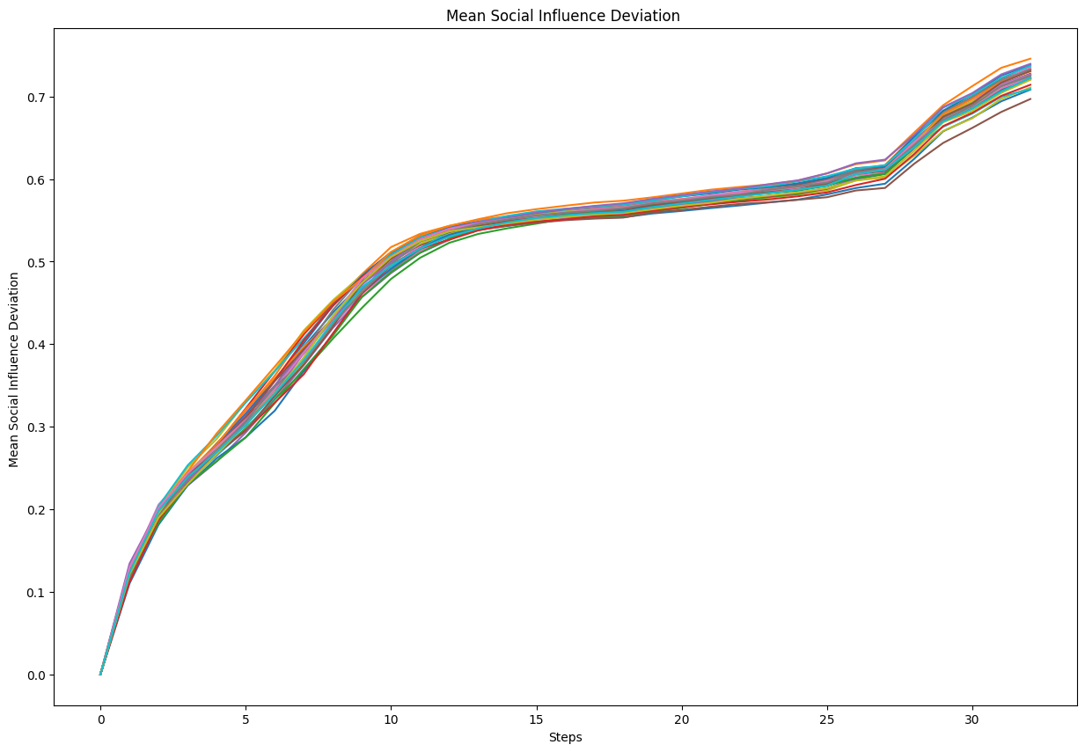
Plots

Slide 31
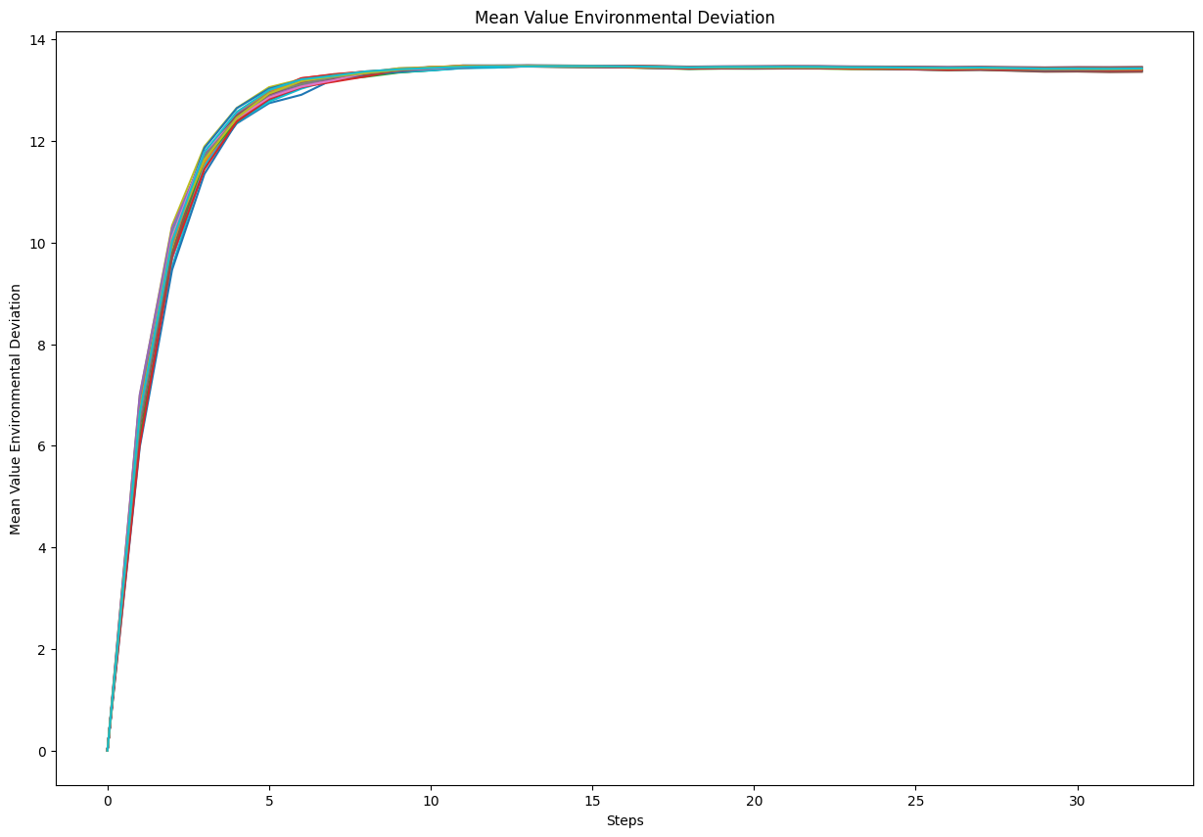
Plots

Slide 32
Question Time
The Mean Social Influence Deviation is showing us that the population is:
A) Overall in accordance with their social values
B) Overall not in accordance with their social values

Slide 33
Question Time
The Mean Value Environmental Deviation is showing us that the population :
A) Have a strong interest in environement values
B) Don’t consider environmental stakes
C) Make choices that are not in accordance with their environmental values

Slide 34
Response Architecture
Context Paragraph
Trend Analysis Paragraph 1
Trend Analysis Paragraph 2
Trend Analysis Paragraph 3

Slide 35
Faithfulness
Scale : 1 to 5
The proportion of the content in the output that accurately reflects the content present in the input. High faithfulness means that most or all of the original ideas from the input are correctly represented in the output.

Slide 36
Coverage
- Scale 1 to 5
-The extent to which the output includes all relevant and important information from the input without introducing new, unverified ideas (hallucinations). Good coverage means all critical points from the input are present in the output.
WARNING : An information added in the output but absent in the input is making the coverage worse whether the information is relevant or not.
Exemple : Noé is Russian is as bad as Noé is French if this information wasn’t in the input originally

Slide 37
Note
There has to be a trade off whenever you assess reports :
If the LLM is describing a trend as increasing while it’s decreasing then it is a bad mistake
If the LLM is describing a value as 3000 units rather than 2800 units, then it is not that bad

Slide 38
The study aims to represent different mechanisms for how agents choose their modes of transportation. The model simulates 500 urban residents occupying random positions in a mid-sized city. Each agent has a disposition to consider alternative transportation modes, determined by either a preference-based or an availability-based approach. The model aims to explore the influence of transportation preferences, availability of public and private transport options, and urban infrastructure on the daily movement and interaction of city residents. Specifically, the goal is to replicate the changes in transportation behaviors and usage patterns of different mobility options over time. The study compares the model to observed urban mobility patterns.
Mean private car usage per agent starts at a high value of around 2700 units and experiences a sharp decline over the first 5 time steps, dropping to around 1200 units. This initial drop indicates that agents are rapidly adjusting their transportation habits in response to changes in the simulation environment. The mean public transport usage per agent starts at a lower value of around 0 units and rapidly increases, showing a shift in preferences or the availability of public transport options. The total number of private car choices made by agents starts low and exhibits a consistent linear increase over the simulation steps until 2700 units, suggesting a stable upward trend. The total number of public transport choices made by agents increases steadily throughout the simulation, to finally reach 27000 units, reflecting changing preferences towards public transport.

Slide 39
The total number of transportation choices made by all agents exhibits a linear increase over time, starting from zero and reaching approximately 30000 total choices by the final time step of 30. This suggests that agents in the simulation are making transportation choices at a stable, unchanging frequency throughout the observed period. The mean distance traveled by private car by the agents starts at around 2700 units, rapidly decreases to about 1200 units over the first 5 time steps, and then continues to decline more slowly. Conversely, the mean distance traveled by public transport starts at around 200 units and increases sharply to approximately 1400 units over the first 5 time steps, showing a growing adoption of public transport.
The mean habit factor for private car usage starts around 1.0, indicating no initial habitual preference. It rapidly increases in the early stages to finally reach 1.05 units, suggesting mild formation of habits towards private car usage. The mean habit factor for public transport usage starts at around 1.0 and exhibits a gradual but consistent upward trend reaching 1.6 unit by the end of the simulation, reflecting a strengthening habit formation among consumers as they repeatedly use public transport. The mean value social deviation starts low and increases rapidly, indicating a divergence in agents' understanding of the social implications of their transportation choices. Similarly the mean value environmental deviation starts around zero to rapidly stabilize around 13 units, indicating an important gap between agents choices and their environmental values.

Slide 40
Faithfulness : 5, Coverage 5

Slide 41
The study aims to represent different mechanisms for how agents choose their modes of transportation. The model simulates 500 urban residents occupying random positions in a mid-sized city. Each agent has a disposition to consider alternative transportation modes, determined by either a preference-based or an availability-based approach. The model aims to explore the influence of transportation preferences, availability of public and private transport options, and urban infrastructure on the daily movement and interaction of city residents. Specifically, the goal is to replicate the changes in transportation behaviors and usage patterns of different mobility options over time. The study compares the model to observed urban mobility patterns. The final goal of this simulation is to promote the RATP.
Mean private car usage per agent starts at a high value of around 2700 units and experiences a sharp decline over the first 5 time steps, dropping to around 1200 units. This initial drop indicates that agents are rapidly adjusting their transportation habits in response to changes in the simulation environment. The mean public transport usage per agent starts at a lower value of around 0 units and rapidly increases, showing a shift in preferences or the availability of public transport options. The total number of private car choices made by agents starts low and exhibits a consistent linear increase over the simulation steps until 2700 units, suggesting a stable upward trend. The total number of public transport choices made by agents increases steadily throughout the simulation, to finally reach 27000 units, reflecting changing preferences towards public transport.

Slide 42
The total number of transportation choices made by all agents exhibits a linear increase over time, starting from zero and reaching approximately 30000 total choices by the final time step of 30. This suggests that agents in the simulation are making transportation choices at a stable, unchanging frequency throughout the observed period. The mean distance traveled by private car by the agents starts at around 2700 units, rapidly decreases to about 1200 units over the first 5 time steps, and then continues to decline more slowly. Conversely, the mean distance traveled by public transport starts at around 200 units and increases sharply to approximately 1400 units over the first 5 time steps, showing a growing adoption of public transport and especially the adoption of tramway .
The mean habit factor for private car usage starts around 1.0, indicating no initial habitual preference. It rapidly increases in the early stages to finally reach 1.05 units, suggesting mild formation of habits towards private car usage. The mean habit factor for public transport usage starts at around 1.0 and exhibits a gradual but consistent upward trend reaching 1.6 unit by the end of the simulation, reflecting a strengthening habit formation among consumers as they repeatedly use public transport. The mean value social deviation starts low and increases rapidly, indicating a divergence in agents' understanding of the social implications of their transportation choices. Similarly the mean value environmental deviation starts around zero to rapidly stabilize around 13 units, indicating an important gap between agents choices and their environmental values.

Slide 43
Faithfulness : 3, Coverage : 3

Slide 44
The study aims to represent different mechanisms for how agents choose their modes of transportation. The model simulates 500 urban residents occupying random positions in a mid-sized city. Each agent has a disposition to consider alternative transportation modes, determined by either a preference-based or an availability-based approach. Each agent can only take the tramway or the bus as public transportation. The model aims to explore the influence of transportation preferences, availability of public and private transport options, and urban infrastructure on the daily movement and interaction of city residents. Specifically, the goal is to replicate the changes in transportation behaviors and usage patterns of different mobility options over time. The study compares the model to observed urban mobility patterns.
Mean private car usage per agent starts at a high value of around 4000 units and experiences a sharp decline over the first 5 time steps, dropping to around 1200 units. This initial drop indicates that agents are rapidly adjusting their transportation habits in response to changes in the simulation environment. The mean public transport usage per agent starts at a lower value of around 0 units and rapidly increases, showing a shift in preferences or the availability of public transport options. The total number of private car choices made by agents starts low and exhibits a consistent linear increase over the simulation steps until 2700 units, suggesting a stable upward trend. The total number of public transport choices made by agents increases steadily throughout the simulation, to finally reach 27000 units, reflecting changing preferences towards public transport.
Mean cycling usage starts at around 500 units and shows a gradual increase over the first 10 time steps, stabilizing at around 1200 units. This indicates a growing acceptance and adoption of cycling as a viable mode of transport among agents. Walking usage, on the other hand, starts at 700 units and remains relatively stable throughout the simulation, suggesting that walking preferences are less influenced by the changes in the simulation environment.

Slide 45
The mean distance traveled by bicycle starts at around 300 units and steadily increases to 900 units by the final time step, indicating a rising preference for cycling. The mean distance walked by agents begins at 500 units and remains relatively constant throughout the simulation, suggesting consistent walking behavior. The total number of bicycle choices made by agents exhibits a steady rise, reaching 12,000 by the final time step, while the total number of walking choices remains stable at around 8,000 choices. The total number of transportation choices made by all agents exhibits a linear increase over time, starting from zero and reaching approximately 30000 total choices by the final time step of 30. This suggests that agents in the simulation are making transportation choices at a stable, unchanging frequency throughout the observed period. The mean distance traveled by private car by the agents starts at around 2700 units, rapidly decreases to about 1200 units over the first 5 time steps, and then continues to decline more slowly. Conversely, the mean distance traveled by public transport starts at around 200 units and increases sharply to approximately 1400 units over the first 5 time steps, showing a growing adoption of public transport.
The mean habit factor for private car usage starts around 1.0, indicating no initial habitual preference. It rapidly increases in the early stages to finally reach 1.05 units, suggesting mild formation of habits towards private car usage. The mean habit factor for public transport usage starts at around 1.0 and exhibits a gradual but consistent upward trend reaching 1.6 unit by the end of the simulation, reflecting a strengthening habit formation among consumers as they repeatedly use public transport. The mean value social deviation starts high and decreases rapidly, indicating a divergence in agents' understanding of the social implications of their transportation choices. Similarly the mean value environmental deviation starts around zero to rapidly stabilize around 13 units, indicating an important gap between agents choices and their environmental values.

Slide 46
Faithfulness : 1, Coverage : 1

Slide 47

Plots

Slide 48

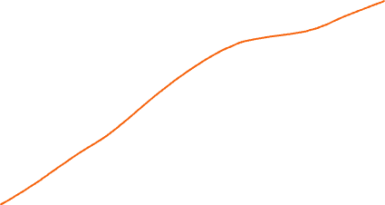
Plots

Slide 49
The study aims to represent different mechanisms for how agents choose their modes of transportation. The model simulates 500 urban residents occupying random positions in a mid-sized city. Each agent has a disposition to consider alternative transportation modes, determined by either a preference-based or an availability-based approach. The model aims to explore the influence of transportation preferences, availability of public and private transport options, and urban infrastructure on the daily movement and interaction of city residents. Specifically, the goal is to replicate the changes in transportation behaviors and usage patterns of different mobility options over time. The study compares the model to observed urban mobility patterns. This model was requested by the city of Paris in a way to reduce the number of cars.
Mean private car usage per agent starts at a high value of around 2700 units and experiences a sharp decline over the first 5 time steps, dropping to around 1200 units. This initial drop indicates that agents are rapidly adjusting their transportation habits in response to changes in the simulation environment. The mean public transport usage per agent starts at a lower value of around 0 units and rapidly increases, showing a shift in preferences or the availability of public transport options. The total number of private car choices made by agents starts low and exhibits a consistent linear increase over the simulation steps until 2700 units, suggesting a stable upward trend. The total number of public transport choices made by agents increases steadily throughout the simulation, to finally reach 27000 units, reflecting changing preferences towards public transport.
The mean distance traveled by bicycle starts at around 300 units and steadily increases to 900 units by the final time step, indicating a rising preference for cycling. The mean distance walked by agents begins at 500 units and remains relatively constant throughout the simulation, suggesting consistent walking behavior.

Slide 50
The total number of transportation choices made by all agents exhibits a linear increase over time, starting from zero and reaching approximately 30000 total choices by the final time step of 30. This suggests that agents in the simulation are making transportation choices at a stable, unchanging frequency throughout the observed period. The mean distance traveled by private car by the agents starts at around 2700 units, rapidly decreases to about 1200 units over the first 5 time steps, and then continues to decline more slowly. Conversely, the mean distance traveled by public transport starts at around 200 units and increases sharply to approximately 1400 units over the first 5 time steps, showing a growing adoption of public transport. Mean cycling usage starts at around 500 units and shows a gradual increase over the first 10 time steps, stabilizing at around 1200 units. This indicates a growing acceptance and adoption of cycling as a viable mode of transport among agents.
The mean habit factor for private car usage starts around 1.0, indicating no initial habitual preference. It rapidly increases in the early stages to finally reach 1.05 units, suggesting mild formation of habits towards private car usage. The mean habit factor for public transport usage starts at around 1.0 and exhibits a gradual but consistent upward trend reaching 1.6 unit by the end of the simulation, reflecting a strengthening habit formation among consumers as they repeatedly use public transport. The mean value social deviation starts low and increases rapidly, indicating a divergence in agents' understanding of the social implications of their transportation choices. Similarly the mean value environmental deviation starts around zero to rapidly stabilize around 13 units but suddenly drops to zero at the very end of the simulation indicating awareness among the population for environmental concerns.

Slide 51
Faithfulness : 5, Coverage 2

Slide 52

Plots

